Slide 1
Counseling & Advising Updates
Melissa Shaquid Pirie
Director of Student and Academic Support Services
Casey Sims
Counseling Department Chair

Slide 2
Recent History
2011
Began decentralized model of counseling
Continued with a mixed model of advising
Added area-specific advisors that serve as liaisons with counseling

Slide 3
Advising model
Training
Resources
Guidelines
Crafted Materials
Assessment & Evaluation
Student and Faculty
Formal and Informal
Relationships
Interdepartmental
Faculty Advisors
Staff

Slide 4
Counseling model
Individual Career and Retention Counseling
Teach Human Development Classes
Serve as Liaison to Divisions
Provide response to urgent campus events
* And other appropriate faculty responsibilities.

Slide 5
Central Advising Unit
Jodi Stapleton
PT Advisor
focus on THOW
Colleen Bowers
PT Advisor
focus on Transfer
Ryan Stewart
PT Advisor
Focus on ABE/Skills
Phil Reid
FT Advisor
focus Health Sciences
Heather Arbuckle
Lead Advisor focus on THOW
Sunny Olsen
FT Advisor
focus on Transfer
Enrique Farrera
FT Advisor
focus on Vets and ESL
PJ Martineau
FT Advisor
focus on Athletes

Slide 6
Teamwork & Tools
Cohort management
Classroom visits
Consultation with faculty
Updates in moodle
Interdepartmental referral networks (DRC, Vets, Counseling, Advising, Testing, CASE)
System Support Specialist /data reporting

Slide 7
Counseling & Advising
Heather Arbuckle
Lead Advisor focus on THOW
Sunny Olsen
FT Advisor
focus on Transfer
Enrique Farrera
FT Advisor
focus on Vets
PJ Martineau FT Advisor
focus on Athletes
Casey Sims
Counseling Chair
focus on THOW
Stephanie Schaeffer
FTF Counseling
focus on Transfer
Lupe Martinez
FTF Counseling
focus On ABE /Skills
Margie Gibler
PT Counseling
focus on Health Sciences
Jodi Stapleton
PT Advisor
focus on THOW
Colleen Bowers
PT Advisor
focus on Transfer
Ryan Stewart
PT Advisor
Focus on ABE/Skills
Phil Reid
FT Advisor
focus Health Sciences

Slide 8
Cohort Numbers
8,655 students enrolled for fall term
Transfer 3,044
(AAOT ASOT)
Basic Skills
784
THOW 1,114
Served outside the cohort model
4,402
(Undeclared or C-Tech)

Slide 9
Future work for Advising
Increase access to advising & resources through technology and innovation
Increase relationships with faculty advisors
Use “network strategy” of support
Student
Peer Assistants
Counseling
Instruction
Advising

Slide 10
Counseling coverage & locations
Casey Sims
Counseling Chair
focus on THOW
Stephanie Schaeffer
FTF Counseling
focus on Arts & Sciences
Lupe Martinez
FTF Counseling
focus AFAC (ABE /Skills)
Ignacio
Gonzales-Reyes
PTF Counseling
Margie Gibler PTF Counseling
Barlow 250
Community
Center
McLoughlin 247
Dye 140

Slide 11
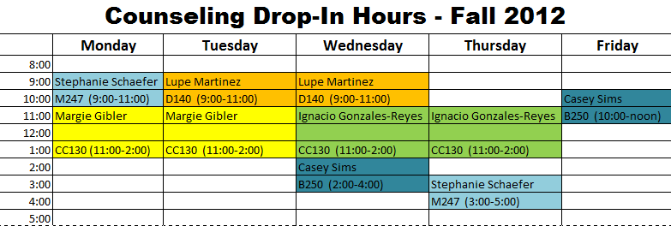
Counseling service model
In 2012, the counseling department developed a new online referral system
All counselors now work by appointment and drop-in

Slide 12
Three year outlook
Continued refinement of the cohort model
Enhanced support of first-year students through year long counseling curriculum
Options for appointments, advising, and counseling work via distance
Integration of faculty advising, and CASE services into a full model of support for students

Slide 13
Thank you for joining us, we welcome your questions.

